Slide 1
Decision Trees
An example using the Iris Dataset

Slide 2
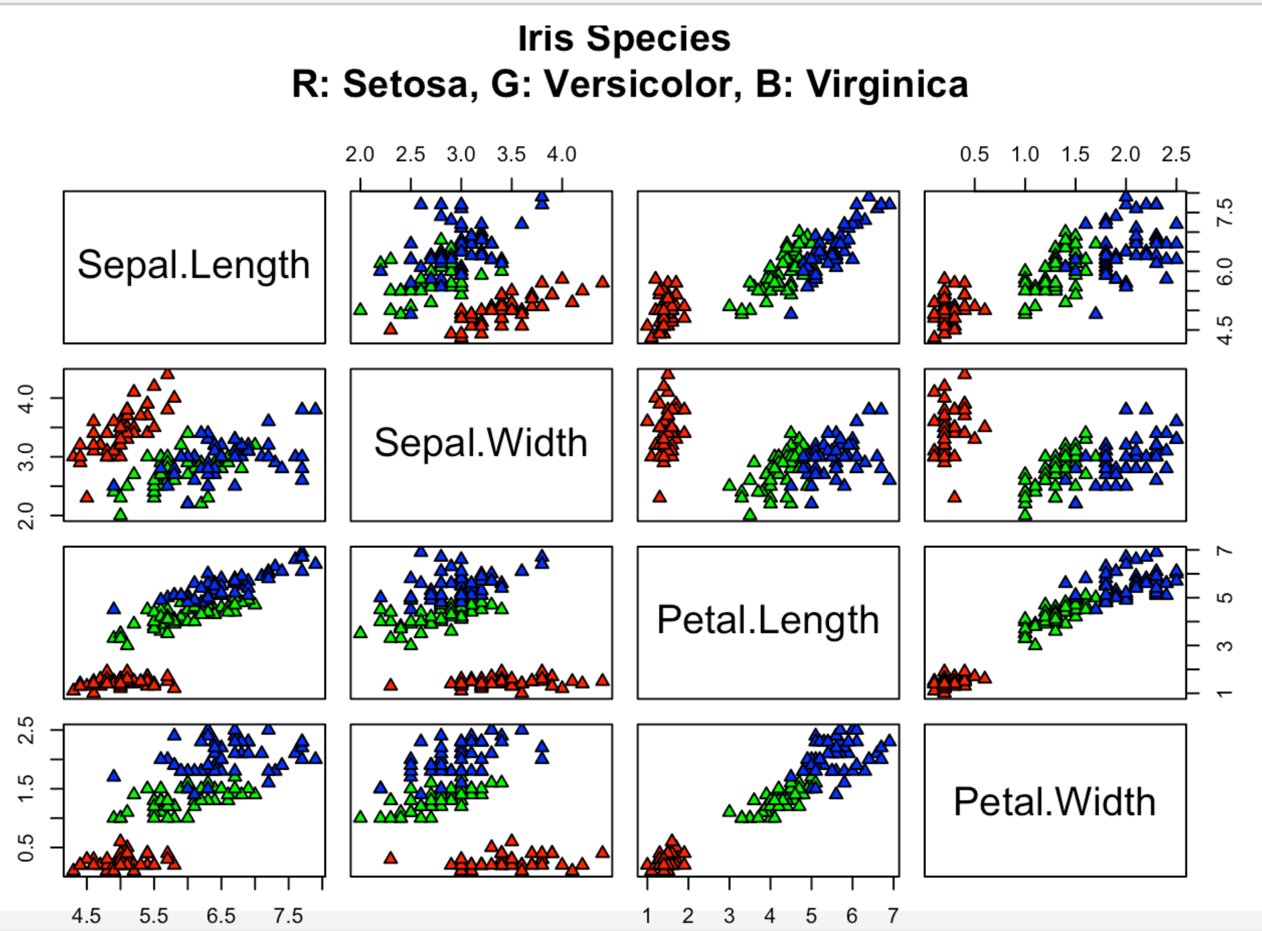
pairs(iris[,-which(names(iris) == "Species")], pch=24, bg=c("red","green","blue")[unclass(iris$Species)],
main="Iris Species\n R: Setosa, G: Versicolor, B: Virginica")

Slide 3
In this case we can divide into groups fairly well with two selection criteria:
if (iris$Petal.Length < 2.5) { prediction <- "Setosa" }
else if (iris$Petal.Width < 1.75) { prediction <- "Versicolor" }
else { prediction <- ”Virginia" }

Slide 4
Design a set of logical decisions or “cuts” to divide the data into subsets or nodes.
For regression problems aim to minimize RSS within node. (Residuals compared to mean value of data in the node set.)
For classification aim to divide into nodes that have high purity (most data in node set is of single type) hence low misclassification rate (we classify based on majority data class in the node set).

Slide 5
Design a set of logical decisions or “cuts” to divide the data into subsets or nodes.
When working with trees the measures of divergence through RSS calculation (regression) or cross entropy calculation (classification) are used.
These are alternative ways to measure the difference in data values within nodes that prove more useful when constructing trees.

Slide 6
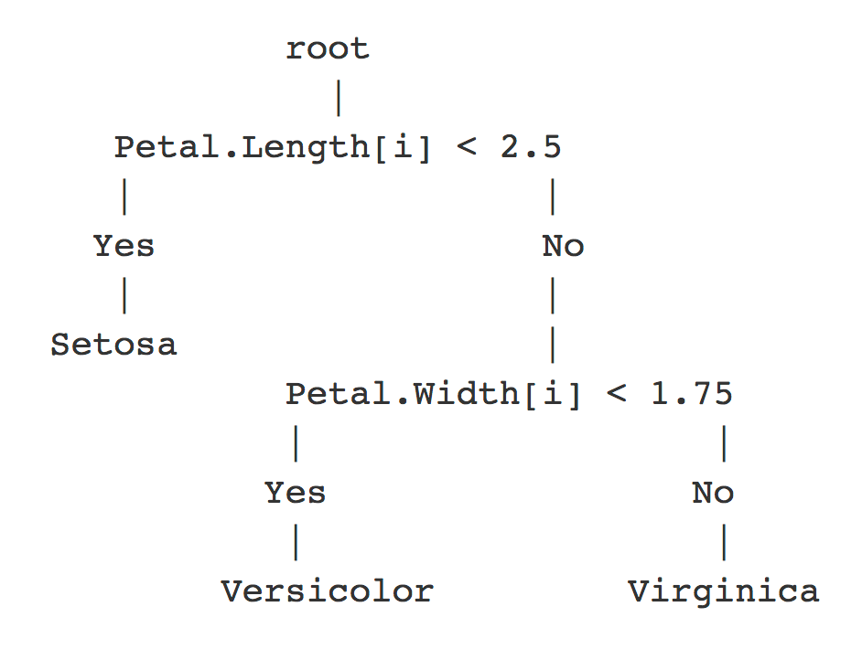
R Code
decision_prediction = rep("None",nrow(iris))
for (i in 1:nrow(iris)) {
if (iris$Petal.Length[i] < 2.5) { decision_prediction[i] <- "setosa" }
else {
if (iris$Petal.Width[i] < 1.75) { decision_prediction[i] <- "versicolor" }
else {
decision_prediction[i] <- "virginica" }
}
}
Diagram

Slide 7
With enough decisions or branches we can build a tree that has one data point in each node and so will exactly predicts the training data with no errors.
This is overfitted.
As well as fitting the underlying relationship our decision tree has fitted to the noise!
We need to limit number of nodes, to allow us to fit underlying trends without fitting to noise.
High variance – tree for different training set will look different because noise looks different.
If we limit node number too much we face the danger of being unable to describe true trends in data accurately. Fitted model will have bias.

Slide 8
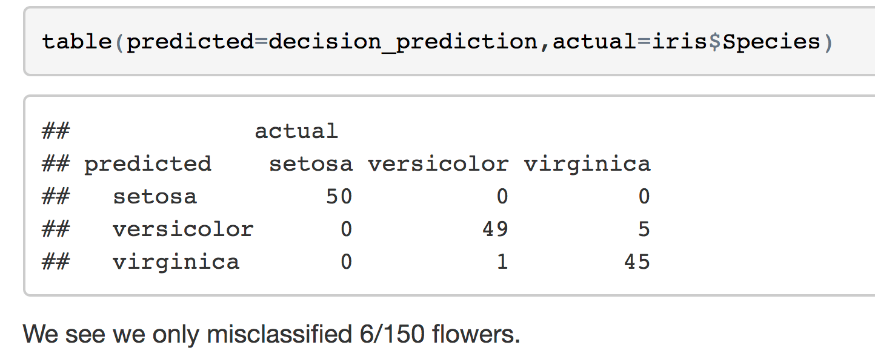
Results

Slide 9
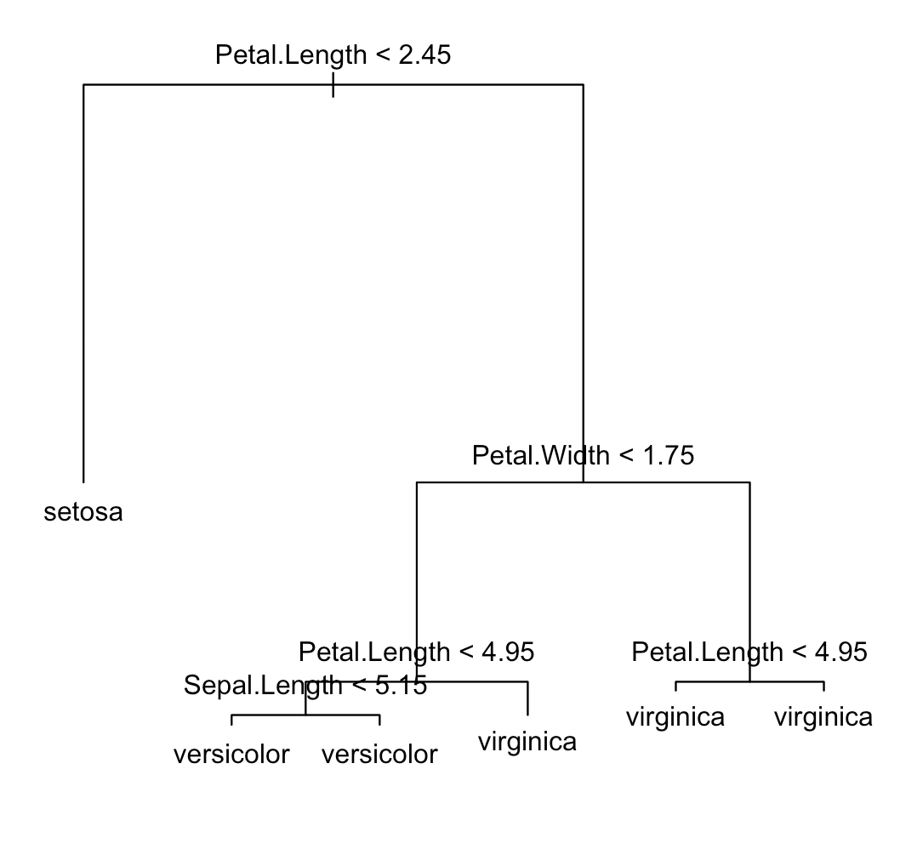
library(tree)
tree.iris = tree(Species~., iris)
plot(tree.iris)
text(tree.iris, pretty = 0)

Slide 10
> summary(tree.iris)
Classification tree:
tree(formula = Species ~ ., data = iris)
Variables actually used in tree construction:
[1] "Petal.Length" "Petal.Width" "Sepal.Length"
Number of terminal nodes: 6
Residual mean deviance: 0.1253 = 18.05 / 144
Misclassification error rate: 0.02667 = 4 / 150

Slide 11
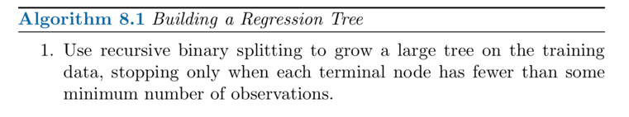
or when the deviance/purity of the node meets a stopping criteria

Slide 12
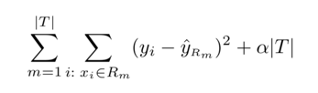
To build a tree we add branches, choosing each branching point to minimize the deviance of the final tree nodes.
e.g. for Regression
Sum over each node of RSS.
Residuals measured with respect to the mean node value.
Continue until a stopping criteria is met:
Minimum number of entries per node
No further node splits improve RSS over some minimum threshold

Slide 13
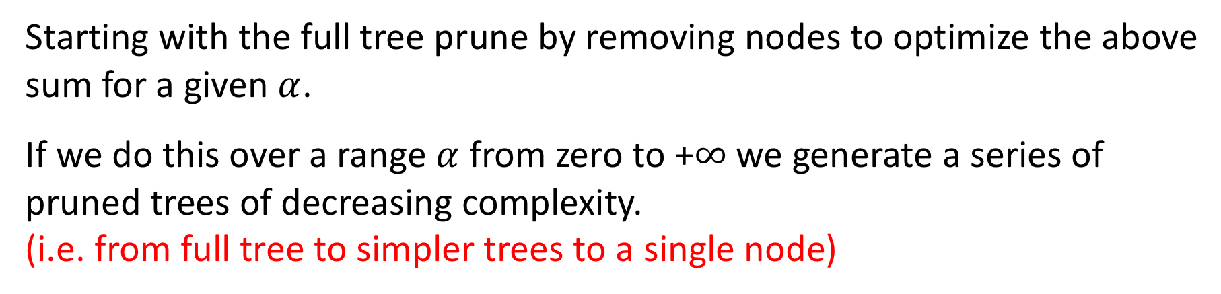
To prune a tree we look at how the tree is affected by the addition of a penalty term (similar to ridge regression/lasso method).
e.g. for Regression
Sum over each node of RSS.
Add penalty based on the number of nodes in the tree.
Starting with the full tree prune by removing nodes to optimize the above sum for a given $α$.
If we do this over a range $α$ from zero to +$∞$we generate a series of pruned trees of decreasing complexity.
(i.e. from full tree to simpler trees to a single node)

Slide 14
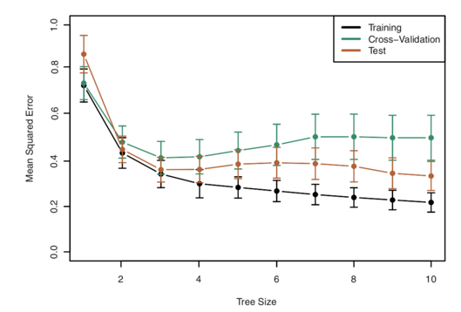

If we do this over a range $α$ from zero to +$∞$we generate a series of trees of decreasing complexity.
We can then run a cross validation study to measure the performance of the different pruning levels.
cv.tree()

